Slide 1
The University of the West of England, Bristol

Slide 2
Higher Education and the Sustainability Agenda. Opportunities and Challenges Global Challenges Annual Lecture University of Brighton
Presented by
Professor Jim Longhurst
AVC Environment and Sustainability
UWE Bristol
Date
27th October 2022

Slide 3
Presentation Outline
Part one will consider the changing expectations of current and future students as they confront the reality of the climate and ecological emergencies.
Part two will be a discussion of whole institution responses to the sustainability challenge facing higher education including consideration of sustainability within the curriculum, research and knowledge exchange, civic engagement and campus operations. This will be illustrated by a case study of UWE’s sustainability journey exploring key drivers for action and challenges encountered.
Part three will provide an overview of the QAA and Advance HE Education for Sustainable Development Guidance, including the ESD resources produced by the two agencies and conclude by discussing how these can be used in different disciplines, settings and context.
Audience participation and questions positively welcomed.

Slide 4
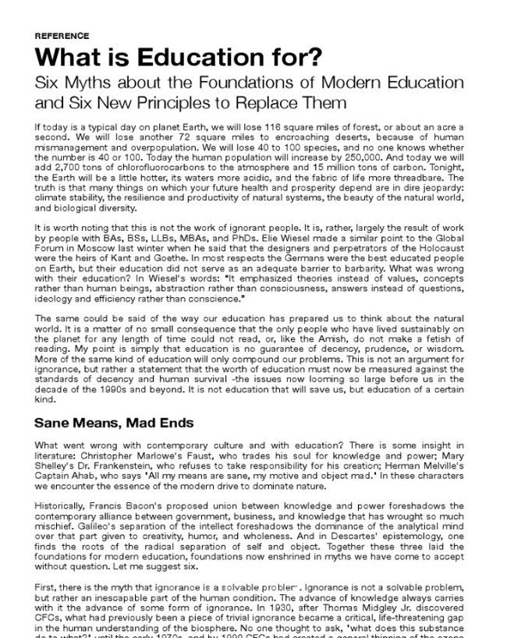
Education – the Problem?
In his 1991 paper What is Education for? David Orr, Emeritus Professor, Oberlin College said
“Many things on which your future health and prosperity depend are in dire jeopardy: climate stability, the resilience and productivity of natural systems, the beauty of the natural world, and biological diversity.”

Slide 5
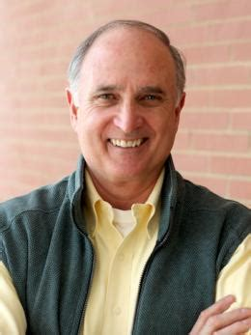
How Did We Get Here?
Well as Orr also said
“It is worth noting that this is not the work of ignorant people. It is, rather, largely the result of work by people with BAs, BScs, LLBs, MBAs, and PhDs”.
https://www.oberlin.edu/david-orr

Slide 6
Education: a (Partial) Solution?
So, if Education is partly the cause of our environmental misfortune might it be a partial solution?
As Albert Einstein allegedly said
“The significant problems we face today cannot be solved at the same level of thinking we were at when we created them.”
Einstein reminded us that doing the same thing over and over again and expecting different results does not result in the desired outcome. We must change.
Voltaire said “No problem can withstand the assault of sustained thinking”.
Universities are good at thinking but we must translate thought into action.
So, how is UWE Bristol addressing this challenge?

Slide 7
Part One
The changing expectations of current and future students as they confront the reality of the climate and ecological emergencies.

Slide 8
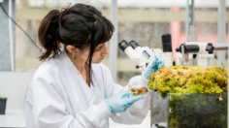
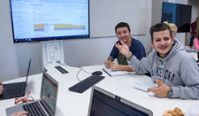
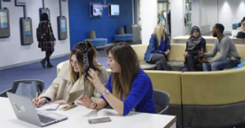
Tomorrow’s Graduates Will Live Through the Climate and Ecological Crises
According to Actuary Tables a student leaving a UK university this year can expect to live at least another 60 years.
Despite the efforts promised by international actors by the 2080s there will be wide ranging, adverse climate and ecological changes.
The graduates will live through these profound changes.
How will their educational experience prepare them for the challenges that they will encounter in their professional and private lives?
Crises manifesting themselves in rising levels of eco anxiety amongst students and young people.

Slide 9
Graduates Will Live Through the Climate and Ecological Crises
The graduates of a university represent the largest sustainability impact of the institution.
In their 60 years of life post university a graduate who uses the sustainability knowledge, skills and attributes acquired at university will tread more lightly on the planet.
We have a collective responsibility to ensure that all of our students are prepared for the adverse future in which they will live their lives.

Slide 10
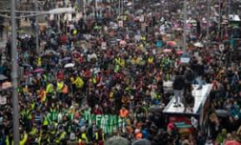
The Next Cohort of Students
Will be much more concerned about the climate and ecological emergency.
They will expect their institution
To take the climate emergency seriously
To manage their estate wisely
To include carbon literacy /climate awareness within the formal and informal curriculum
To prepare them for the challenges they will face across their life course, professional and private, as they live through a changing climate.
Image copyright The Guardian
https://www.theguardian.com/environment/2020/feb/28/greta-thunberg-bristol-schools-shut-students-join-climate-strike#img-1

Slide 11
Future Students
Summer 2020 Survey by Zurich Insurance of young people aged 7 - 17.
Major concern expressed about the impact of and lack of action on the climate emergency
Young people want to see climate included in the formal school curriculum.
(https://www.zurich.co.uk/en/about-us/media-centre/company-news/2020/millions-of-young-people-want-more-climate-change-education)
Institution of Engineering and Technology survey of children aged 5 -13
Over two-thirds of children (68%) hope to follow a career that helps the environment
Lack of understanding about these jobs could stop them from getting there.
(https://www.theiet.org/media/press-releases/press-releases-2020/press-releases-2020-july-september/18-september-2020-generation-green-ambitions-at-risk-of-going-to-waste)

Slide 12
NUS - SOS Surveys
Annual survey by NUS then SOS of students attitudes to sustainability
2021 Survey of 8000 students
91% say their place of study should actively incorporate and promote sustainable development.
84% would like to see sustainable development incorporated in all courses.
66% say sustainable development is something they would like to learn more about.
https://www.sos-uk.org/research/sustainability-skills-survey

Slide 13
Part Two
Whole institution responses to the sustainability challenge facing higher education: a case study of UWE Bristol

Slide 14
UWE Bristol
30 000 plus students in the UK from 163 countries
c8000 transnational students
4000 staff
Annual income of approximately c£334 million
3 campus locations Frenchay, City Campus and Glenside
Three Colleges
Arts, Technology and Environment
Business and Law
Health, Science and Society

Slide 15
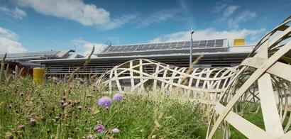
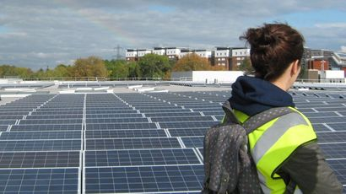
Our Commitment to Climate Action and Sustainability
"It is about recognising that we are one planet, one world. We all have a collective responsibility to engage individually and collectively… to move to a different place in our mindset and our actions. This is a hugely important agenda that is going to be with us forever"
Professor Steve West,
Vice Chancellor, President and CEO, UWE Bristol.

Slide 16
Our Approach
Integrating Sustainability into Policy, Practice and Culture so that it is present in the purpose and operation of the University.
Teaching and Learning
Research, Innovation and Knowledge Exchange
Local, National and International Partnerships
Campus Operations and Developments
Student and Staff Engagement
Creating a culture supportive of a sustainable university.
All in partnership with the Students' Union.

Slide 17
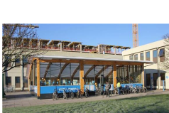
Sustainability at UWE – a 28 year journey
1994 UWE’s first Environmental Policy periodically revised thereafter
1995 Environmental Policy Committees established in Faculties
2004 Sustainability Board established
2004 Sustainability Manager post established
2005 First Sustainability Action Plan
2006 Fairtrade University Status
2007 First Sustainability Strategy
2007 Baseline survey of sustainability in the Modular Scheme
2008 Cross university Knowledge Exchange for Sustainability Education (KESE) group established to promote and enhance ESD across the university
2009 First ESD Action Plan published

Slide 18
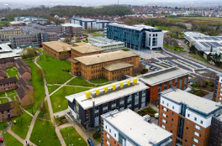
Sustainability at UWE – a 28 year journey
2010 Strategy 2020
2011 Assistant Vice Chancellor Environment and Sustainability established
2011 Waste and Resource Manager post established
2011 Sustainability Engagement Coordinator post established
2011 Annual UWE wide Sustainability and Education Conference established
2012 Sustainability Plan- Positive Footprint
2012 SL in ESD post established
2012 Annual meeting cycle with individual HoDs instigated
2014 ISO 14001 Post established
2014 Certification to ISO 14001:2004 EMS
2015 Internal and external verification that all taught programmes address sustainability in the context appropriate to the individual discipline
2015 Bristol’s Year as European Green Capital
2015 Launch of UWE Green Capital Strategy
2015 Launch of HEFCE Funded Green Capital Student Capital project

Slide 19
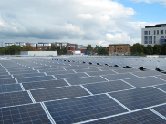
Sustainability at UWE – a 28 year journey
2015 Carbon Action Manager post established
2016 NUS –SOS Responsible Futures accreditation
2016 Annual meeting with Faculty Executive groups instigated
2016 Launch of Sustainable Development Goal (SDG) Mapping Project
2016 Largest single roof mounted PV array in UK HE begins generating
2017 Refreshed Sustainability Plan 2.1
2017 Transition to ISO 14001:2015 EMS
2017 New Environmental Sustainability Policy
2017 Associate Professor in ESD established
2018 KESE Group wins UWE’s first Advance HE Award for Collaborative Approach to Teaching Excellence (CATE)
2019 New Sustainability Communications and Engagement Framework launched

Slide 20
Sustainability at UWE – a 28 year journey
2020 Launch of Transforming Futures Strategy 2030
2020 New Transforming Futures Climate Action and Sustainability Strategy
2021 Completion of Phase 1 of the SDG Mapping Project
2021 New Action Plans for Education for Sustainable Development, Sustainability Engagement, Sustainable Food, Transport, Carbon and Energy Management, Clean Air, Circular Economy including plastics, and Biodiversity
2021 Launch of QAA- Advance HE Education for Sustainable Development Guidance
2021 Reaccreditation to NUS -SOS Responsible Futures and ISO 14001
2021 Work starts on new student accommodation designed to PassivHaus standard
2021 UWE’s Learning, Teaching and Student Experience Committee formally adopts QAA-Advance HE ESD guidance
2022 New carbon literacy training programme for staff and students
2022 UWE Bristol and the SDGs: Programme mapping portfolio published – available in the UWE Research Repository

Slide 21
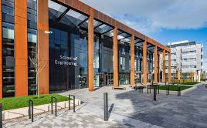
Key Success Factors
Student expectation and demand
Staff engagement
Senior staff leadership
Strategy and clear direction of travel
Willingness to embrace change
Learning from failure
External certification
Partnership with the Students’ Union
Bristol – A European Green Capital

Slide 22
Sustainability Commitments in Strategy 2030
Net-zero emissions of greenhouse gases by 2030.
Clear targets and plans to reduce water and energy use, cut waste generation including food waste, and support biodiversity. Towards a circular economy.
Eliminate all but essential single-use plastic by 2025.
Establish all our campuses as clean air zones.
Secure year-on-year improvement in sustainable travel.
Work with our students to explicitly address climate change and environmental challenges in the curriculum.
Support research that addresses climate change, environmental challenges and biodiversity.
https://www.uwe.ac.uk/about/values-vision-strategy/strategy-2030

Slide 23
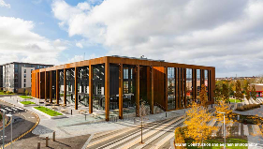
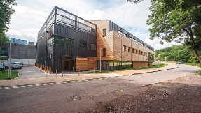
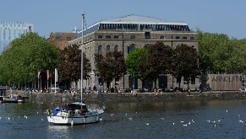
Transforming Futures Climate Action and Sustainability Strategy (CASS ) 2030
Our Commitment to Sustainability
How We Will Manage and Report on Our Actions
Practising Sustainability
Understanding Sustainability
Influencing Sustainability and cross cutting each element Adapting to a Changing World

Slide 24
Action Plans to Implement Strategy 2030
Carbon and Energy Management,
Circular Economy,
Clean Air,
Education for Sustainable Development,
Engagement
Landscape and Biodiversity
Offsetting
Plastics,
Scope 3
Sustainability Engagement,
Sustainable Food,
Transport
Water

Slide 25
Governing Sustainability
Leadership and Governance
Governance is exercised through the Sustainability Board, reporting to the Vice-Chancellor’s Executive and the Board of Governors.
The Assistant Vice-Chancellor for Environment and Sustainability is charged with promoting the integration of sustainability and enhancing the sustainability impact of all our teaching, research, knowledge exchange, operational management and community engagement activities.

Slide 26
The Sustainability Board
Purpose
To enhance the sustainability practices and developments of the university in all its educational and operational endeavours and thereby to enhance the reputation of the university and its attractiveness to current and future students and staff as a place of study or employment.
To consider contemporary and emergent sustainability risks, opportunities and challenges and to advise the University on appropriate actions.
At each meeting, the Board reviews progress with the seven core sustainability commitments of Strategy 2030, undertakes regular reviews of policies including the Environmental Sustainability Policy and the Ethical Investment Policy, approves action plans arising from the Climate Action and Sustainability Strategy, reviews progress with the commitment to adopt the Principles of Responsible Management Education (PRME) across the institution, and provides the governance of the whole institution ISO 14001 certification process and the Responsible Futures accreditation.
Two sub groups: Knowledge Exchange for Sustainability Group and the Climate Action and Sustainability Group

Slide 27
Sustainability Board Assessment June 2022
Strategy 2030 Commitment | Assessment
Net Zero by 2030 | On track
Use ISO 14001 standard to set targets and plans | On track
Eliminate non-essential single use plastics by 2025 | Slippage
Clean air zones | On track
Improvement in travel | On track
Teaching, learning and curriculum | On track
Sustainability in Research | On track

Slide 28
Sustainability Executive Committee
As part of the reorganisation currently underway in UWE the Sustainability Board will become the Sustainability Executive Committee (SEC).
The SEC will have a refreshed and extended membership to reflect the new university structure.

Slide 29
Accreditations and Certifications
ISO14001 - UWE Bristol was awarded its first certification for the international standard BS:EN ISO14001:2004 in July 2014. To ensure successful implementation we undertake regular internal audits and are audited once a year by an external ISO-approved consultant. The certification covered the whole institution, our Estates, Services and Educational provision.
SOS Responsible Futures Accreditation - the University and the SU at UWE, working in partnership, became the first, post pilot phase, institution in the country to be accredited by the NUS to the Responsible Futures mark. This accreditation has been successfully renewed since then.
NUS-SOS Green Impact Students’ Union - The Students’ Union at UWE are the winners of a GISU Special Award for “The Highest Scoring Students’ Union”, for the sixth year in a row!

Slide 30
ISO 14001 Certification
UWE Bristol was awarded its first certification for the international standard BS:EN ISO14001:2004 in July 2014.
The certification covered the whole institution, our Estates, Services and Educational provision.
In 2017 we were one of the first universities to transition to the ISO14001:2015 standard, which requires organisations to adopt a more strategic, integrated and holistic approach when implementing and managing an Environmental Management System (EMS).
The ISO 14001:2015 standard is designed to manage significant aspects, risks and opportunities that result from the operations taking place across the entire university including The Students’ Union at UWE. The scope includes all activities undertaken at all campuses and sites including those of employees and contractors.
Teaching and academic research carried out by staff and students within UWE Bristol's faculties and professional services is included.
To ensure successful implementation we undertake regular internal audits and are audited once a year by an external ISO-approved consultant.

Slide 31
The Green Team in the SU
‘’The Green Team is a group of students who are striving to create sustainable change at an individual and collective level. This year, we will be creating activities, events and campaigns in-person and with some sessions run virtually. Whether you are on or off campus, you can be part of The Green Team activities and campaigns and make a difference!’’
The Green team’s approach to sustainability is intersectional, as the climate emergency is tightly intertwined with inequalities of gender, race and socio-economics. Climate justice = social justice.
The Green Team has a membership of some 1300 students!
https://www.thestudentsunion.co.uk/community/green-team/news/
https://www.thestudentsunion.co.uk/community/green-team/about/

Slide 32
Education for Sustainable Development
The University recognises we have a responsibility to ensure graduates are equipped with the skills, knowledge, capabilities and capacities to contribute to a sustainable future.
Education for Sustainable Development (ESD) sits at the heart of UWE Bristol’s institutional strategy and teaching and learning framework.
UWE Bristol is working to ensure that all programmes of study continue to provide opportunities for students to explore the place of their discipline and related professions in contributing to sustainable development. This claim is subject to regular audit by the ISO 14001 and Responsible Futures processes
https://www.uwe.ac.uk/about/values-vision-strategy/sustainability/education-for-sustainable-development

Slide 33
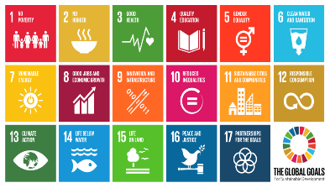
Education for Sustainable Development
We have also been using the SDGs since 2015 to review modules, programmes, teaching, learning and assessment across all of our programmes of study.
Our annual ESD Action Plan specifies ways our ambitions will be pursued over the coming year, while the annual ESD Report provides an evaluation of our
achievements.
Reporting and evaluation are overseen by the Sustainability Board and the Learning, Teaching and Students Experience Committee.
https://www.uwe.ac.uk/about/values-vision-strategy/sustainability/education-for-sustainable-development

Slide 34
Example of a Programme SDG Map, one of 80 Available at https://uwe-repository.worktribe.com/output/9912189

Slide 35
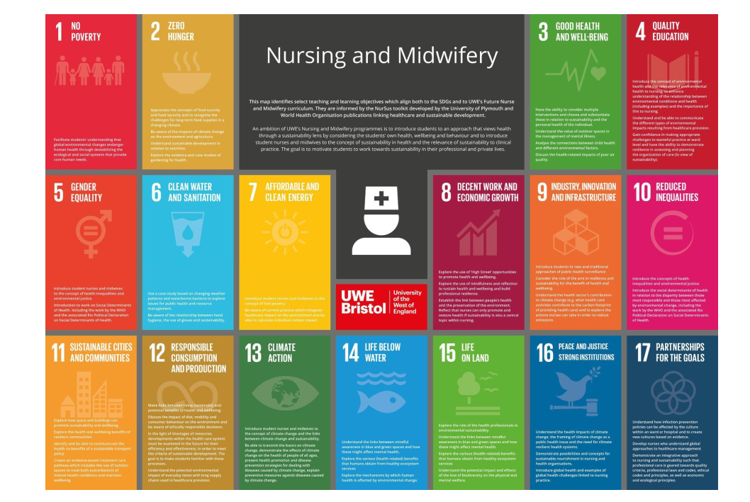

Slide 36
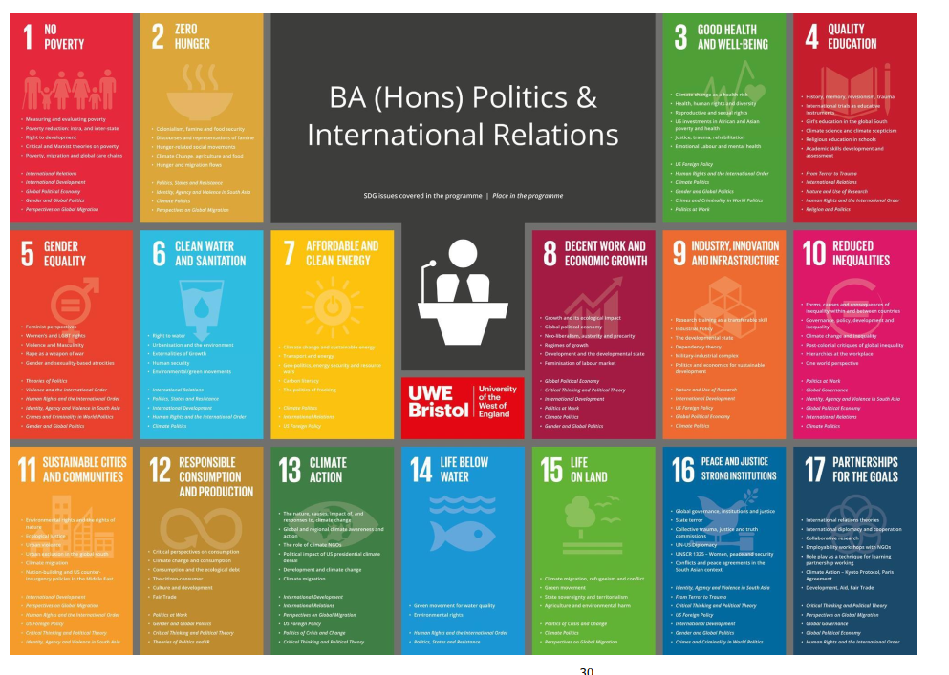

Slide 37
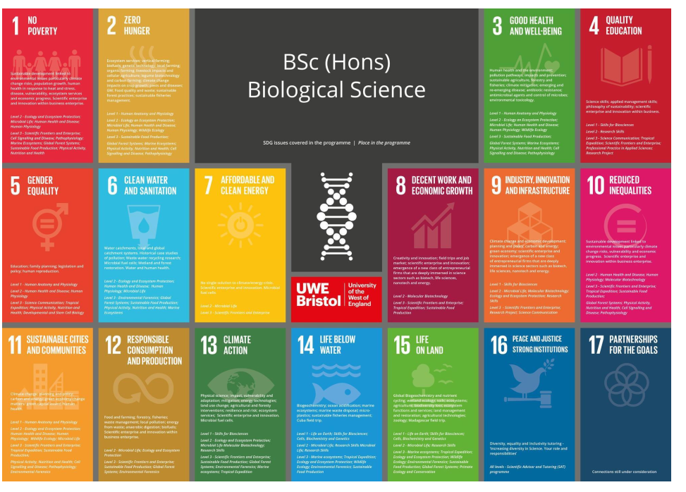

Slide 38
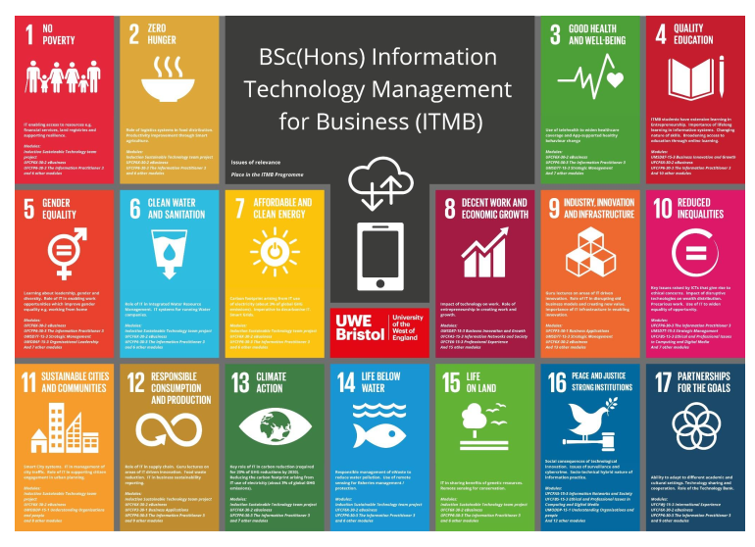

Slide 39
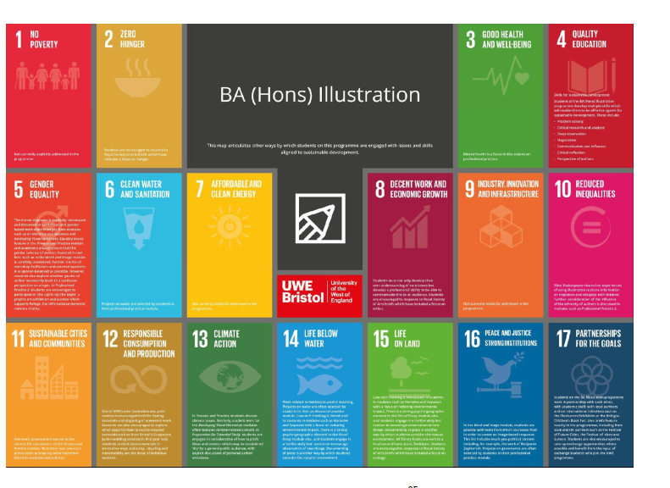

Slide 40
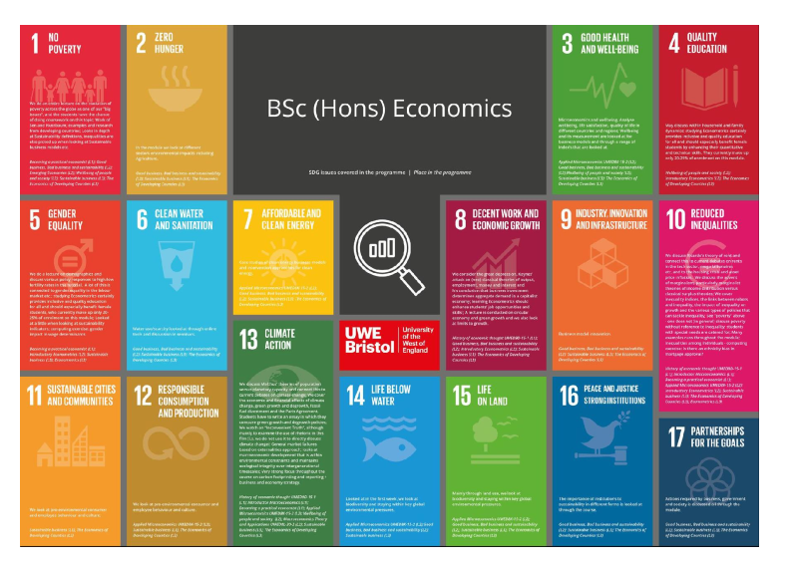

Slide 41
Sustainability and Research
The challenges of global warming, finite resources and shrinking biodiversity could not be clearer – the future of the planet and our world is at stake and we won’t get a second chance. Net-zero carbon buildings, sustainable mobility, green agriculture, emissions and air quality are just some of the critical issues we are tackling.
Our research strengths include: - Transforming construction, infrastructure and design. - Food security, water management and air quality. - Future mobility, connectivity and place.
Ensuring that sustainability is a consideration in the processes of research.

Slide 42
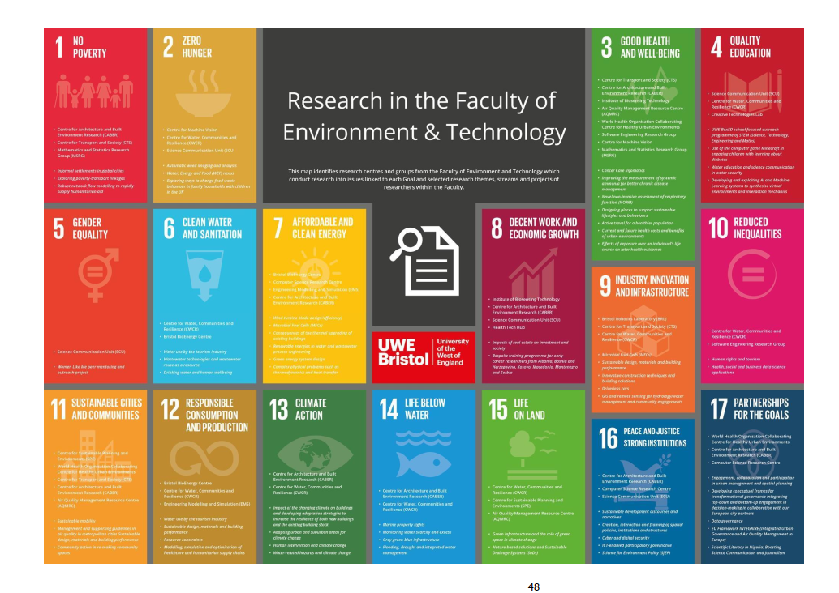
Example of Faculty Research Mapped Against the SDGs
Available at https://uwe-repository.worktribe.com/output/9912189

Slide 43
Conceptualising Climate Change and the SDGs
Causes Primary Impacts
Secondary Impacts
Mediating Actions
Mediating Actions
Changing Climate

Slide 44
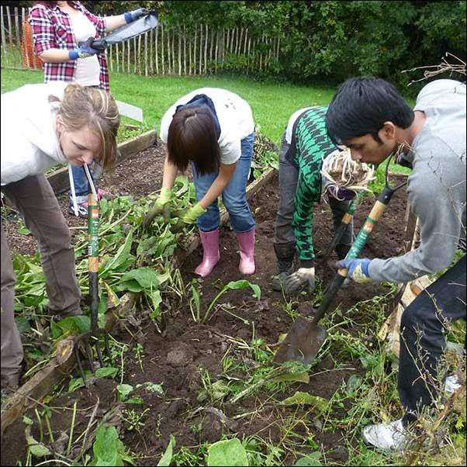
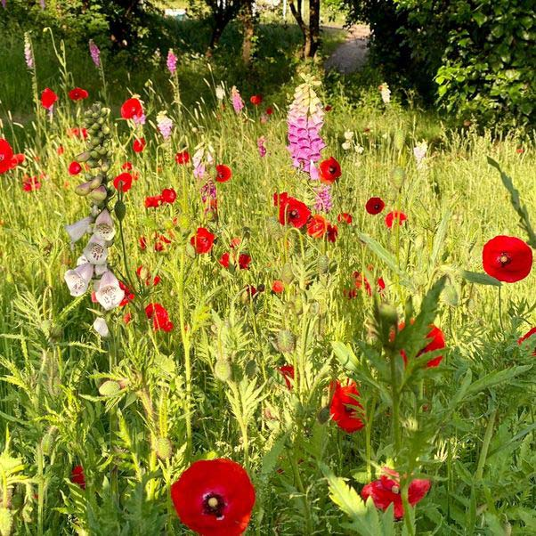
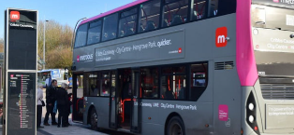
Campus Operations
Reduce, Reuse and Recycle - Circular Economy Plan 2020 – 2024
https://www.uwe.ac.uk/about/values-vision-strategy/sustainability/reduce-reuse-recycle
Travel Action Plan 2030 - 66% of our own fleet will be zero emission by 2025, rising to 100% by 2030; reducing the number of cars travelling onto campus each day by promoting and prioritising sustainable travel options, combined with a 10% per head reduction in car parking spaces available for university activities by 2025, and a 20% reduction by 2030; investing resources into projects improving sustainable travel options.
Biodiversity and Ecology – meadowscaping, increasing artificial habitats, edible planting, biodiversity of ponds, enhancing the community garden, on-site plant nursery to grow key pollinator plants and a native tree sapling nursery, award-winning Frenchay Beeline, new signage (accessible with a QR code) to tell the story of biodiversity on our campuses.
View the Beeline film at https://youtu.be/zg3-BSyYeoI

Slide 45
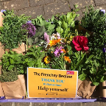
Campus Operations
Hospitality - Sustainable Food – we provide environmentally friendly and healthy food to a receptive audience and seek to encourage a longer-term change in buying and eating habits.
Sustainable Purchasing and Procurement – more than 80% of our carbon footprint comes from goods, services and activities off campus to which procurement is a major contributor. Our strategy is guided by our Responsible Procurement ESG policy.
Clean Air – the UMBRELLA AQ Network - UMBRELLA AQ is a dense, multi pollutant, multi layered, multi location air quality monitoring network integrating high quality, medium quality and low cost sensing devices into one network enabling instrument performance comparison in place and over time. It is the means through which we will demonstrate achievement of clean air on the Frenchay campus.

Slide 46
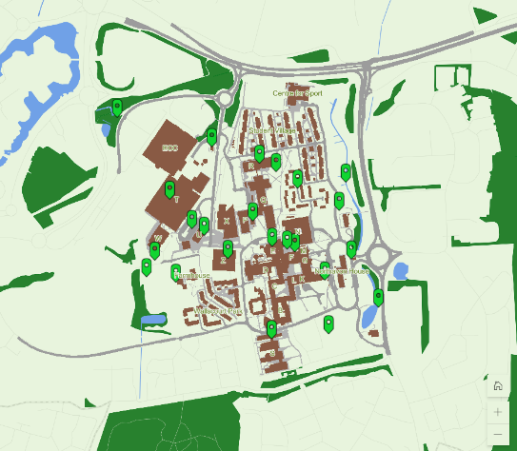
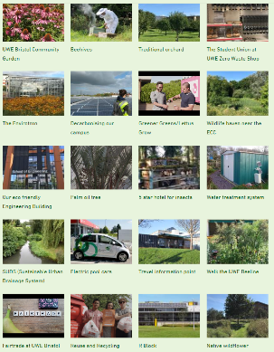
UWE Green Campus map A sustainability tour of Frenchay Campus
https://storymaps.arcgis.com/stories/aa6f24e4adbb4d91a294aa155c09ffd6

Slide 47
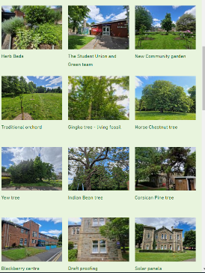
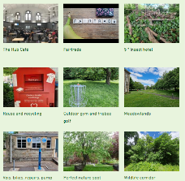
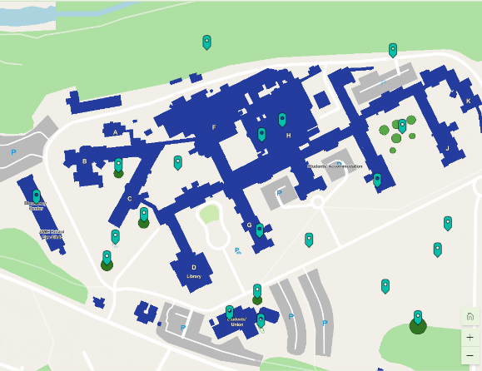
UWE Glenside Green Campus map A sustainability tour of Glenside Campus
https://storymaps.arcgis.com/stories/9924a8f505524ebc89c750baa8aaef0f

Slide 48
Sustainability Partnerships
Working with national partners
Environmental Association of Universities and Colleges.
Climate Commission for Higher and Further Education, helped develop the Climate Action Toolkit for HE and the Climate Roadmap for FE.
Working with UKRI to develop a Concordat on Sustainability in Research and Innovation.
Supporting QAA and Advance HE in developing and implementing new Guidance on Education for Sustainable Development.
Supporting DfE in developing their Climate Change and Sustainability Strategy.

Slide 49
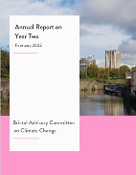
Sustainability Partnerships
Working with local partners
Bristol Green Capital Partnership
Bristol Advisory Committee on Climate Change
South Gloucestershire Climate Emergency University Advisory Group
Business West
Bristol SDG Alliance
Future Leap
Avon Pension Fund engaging with the fund to accelerate decarbonisation of the fund into which Professional Service staff pension contributions are made.

Slide 50
Managing Carbon at UWE - Policy
Climate and Ecological Emergency Declaration by Board of Governors
Institutional Strategy defined
Net Zero 2030 Target
Carbon and Energy Management Plan 2020-2030 developed using Green House Gas Protocol and Science Based Targets Initiative.
Baseline Scope 1, 2 and 3 established
Scope 3 Action Plan developed
Offsetting Plan drafted
Carbon a KPI on Strategy 2030 UWE Corporate Score (a progress tracker)
Carbon emissions on UWE’s Risk Register

Slide 51
The Carbon Management Hierarchy
Avoid
Reduce
Replace
Avoid carbon intensive activities (and rethink business strategy)
Offset
Do whatever you do more efficiently
Replace high-carbon energy sources with low-carbon ones
Offset those emissions which can’t be limited by the above
Actions at the top of the hierarchy are more transformative and lasting in terms of reducing a company’s emissions baseline
Sources: Forum for the Future (2008) Getting to Zero: Defining Corporate Carbon Neutrality

Slide 52
UWE’s Carbon Baseline 2018/19

Slide 53
Managing Carbon at UWE - Practice
Direct Power Purchase Agreement for renewable energy
REGO certified electricity for residual electricity demand
PV arrays at each campus
CHP and District Heating Network on Frenchay Campus
Electrifying the university vehicle fleet
Promoting active travel
EV cars available for use by staff and students
Voi Scooters and Big Issue Electric Bikes for staff /students on campus
Pedal cycle scheme for students
Busy bus interchange on Frenchay Campus

Slide 54
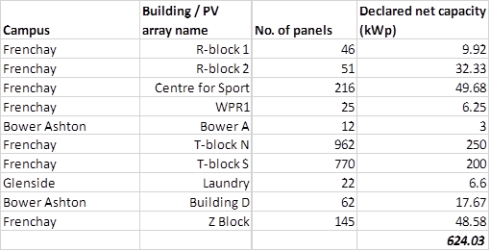
Solar PV Installations and Capacities

Slide 55
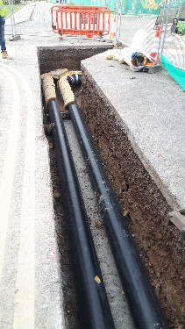
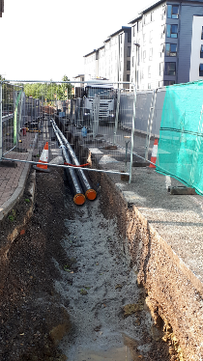
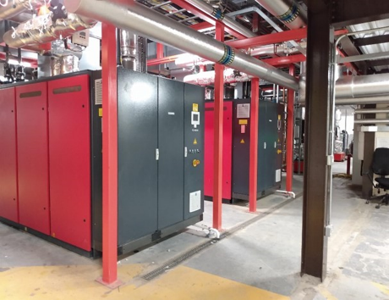
CHP and DHN
CHP engines: 2 x Bosch engines, each with 500kW heat (i.e. total heat capacity 1MW) and 400kWe power (i.e. total power capacity 800kWe).
These are heat-led, so no heat is dumped.
The DHN provides heat to 50% of Frenchay campus.

Slide 56
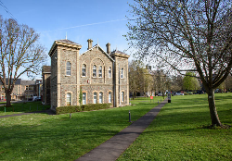
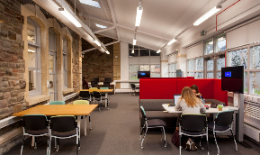
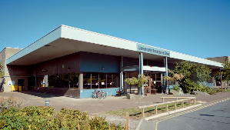
Managing Carbon at UWE
New Student Accommodation designed to PassivHaus Standard
New Engineering Building BREEAM Excellent
BUT
Other developments over the last decade and our historic estate present energy efficiency, emission mitigation and adaptation challenges.

Slide 57
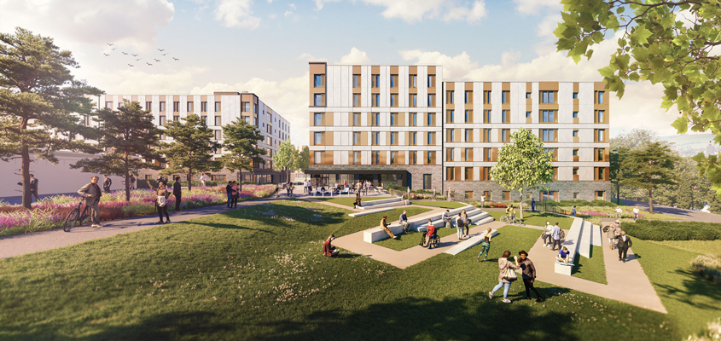
PassivHaus Student Accommodation
Images credit: Stride Treglown

Slide 58
Managing Carbon – Challenges
Mitigation is our focus
Removing gas from the estates is an urgent action but the CHP engines are gas fired!
Understanding the trajectory to 2030 for Scopes 1 and 2
Better understanding the sources and magnitude of Scope 3 emissions and understanding where the control measures may be located
What will be our C compensation or offsetting requirement in 2030?
When to decide on compensation options?
Where to locate compensation actions?
Bringing adaptation into focus as an equal priority

Slide 59
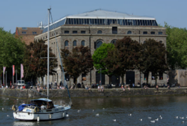
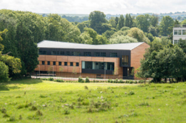
Adaptation and Climate Risk
What is the risk profile for the university site?
Flood, heat, wind?
What are the institutional priorities for adaptation?
Teaching, Research, Sports, Residences?
Critical infrastructure resilience.
Supply chain resilience.
Maintaining access in extreme weather events.
Providing cooling and shade.
Planning for water scarcity.
Risk assessment of climate impacts not fully developed.
When do we need adaptations in place?

Slide 60
Managing Carbon at UWE – Research and Teaching
Changing Climate Research Network established
Sustainability and Climate Change Resilience Research Beacon established
Zero Carbon Building MOOC
Carbon literacy training for staff developed
Carbon literacy and climate awareness being infused into the curriculum as part of SDG mapping – identifying positive and negative impacts of carbon action on other SDGs.
Green Skills for Jobs and Entrepreneurship for young adults from under represented groups
Skills for Clean Growth programme for SMEs in the West of England

Slide 61
Green Gown Awards: Peer Recognition
2022 Finalist in 7 categories
2021 Winner Tomorrow’s Employees, Highly Commended Next Generation Learning and Skills, Research with Impact –Student & Sustainability Champion - Student. Finalist in 4
2020 Winner Total Reporting.
2019 Highly Commended Money for Good), Finalist in 4 categories
2018 Winner Student Engagement and Sustainability Student Champion of the Year. Finalist in 3 categories
2017Finalists in 9 categories, Highly Commended in 3.
2016 Finalists in 6 categories, Winner in 4, Highly Commended in 2.
2016 International Green Gown: Winner in 2 categories.

Slide 62
Sharing Knowledge – Recent Examples
Arts University, Bournemouth
Bath
Brunel,
Cardiff
De Montfort
Edinburgh,
Essex,
Keele,
Manchester Metropolitan,
Plymouth,
Surrey,
Warwick,
Worcester.

Slide 63
Policies, Strategies, Statements, Action Plans and Reports
View all our
Sustainability Policies,
Strategies,
Statements,
Action Plans and
Annual Reports at
https://www.uwe.ac.uk/about/values-vision-strategy/sustainability/strategy-leadership-and-plans/policy-and-strategy-documents

Slide 64
Part Three
The QAA and Advance HE Education for Sustainable Development Guidance, 2021

Slide 65
The QAA – Advance HE Education for Sustainable Development Guidance
Purpose of the Guidance
To assist staff in UK higher education institutes seeking to incorporate Education for Sustainable Development (ESD) within their curricula
To support students from any academic discipline to acquire the knowledge, understanding and skills necessary to develop values and take actions to transition society towards sustainable futures
To support academic and professional service colleagues at all levels, and at all stages in their ESD journey

Slide 66
Content of the Guidance
Section 1: Introducing Education for Sustainable Development
Section 2: Getting Started with Education for Sustainable Development
Section 3: Teaching, Learning and Assessment for ESD
Section 4: Annotated references and resources

Slide 67
Section 1 – Introducing Education for Sustainable Development
What Is Education for Sustainable Development?
The role of higher education in creating a sustainable future
UN Sustainable Development Goals

Slide 68
A Starting Definition of ESD
“’’ U‘ESD empowers learners to take informed decisions and responsible actions for environmental integrity, economic viability and a just society, for present and future generations, while respecting cultural diversity.
It is about lifelong learning, and is an integral part of quality education.
ESD is holistic and transformational education which addresses learning content and outcomes, pedagogy and the learning environment.
It achieves its purpose by transforming society.’
UNESCO (2019) https://en.unesco.org/themes/education-sustainable-development/what-is-esd
NESCO, 2019

Slide 69
How Can it Be Used?
The guidance recognises that there are many ways in which this may be achieved.
It offers suggestions to inspire, inform and enable ESD to be designed into and across curricula as part of a whole-institution approach.
It can be used as both a course design reference point and as an advocacy aid for those supporting ESD agendas in their organisation.

Slide 70
Section 2 – Getting Started with Education for Sustainable Development
ESD as curriculum framing
ESD intersections across curricula
Consulting key players

Slide 71
Section 2. Getting Started with ESD
Section 2. Getting Started with ESD
Applies ESD in practice, discussing how to position ESD strategically and operationally across curricula. It offers guidance and identifies ways of involving key players, beginning with students and continuing through employers, enterprise organisations, academics, professional service teams, governance and communities.
The guidance prioritises engagement with students, in particular collaboration and co-creation of learning, as well as identifying activities that are already happening in their communities.
Emphasises the importance of strategic institution-level commitment and support when looking to progress ESD. It discusses how ESD can reinforce and frame other institutional objectives such as internationalisation and developing global perspectives; promoting employability and enterprise, working with communities, and progressing equality, diversity and inclusion.
Explores how ESD can be used to motivate staff and students to go beyond a focus on their own discipline/subject area is discussed as a means of promoting interdisciplinary working that could help innovative ideas to emerge.

Slide 72
ESD is best achieved when
1. ESD objectives, targets and KPIs are part of the institution’s strategic priorities and subsequent strategies and policies.
2. The framing of ESD within the curriculum is included in the validation of new courses and ongoing review of existing courses.
3. ESD is central to the staff and student induction process, as well as staff appraisal and/or promotion criteria.
4. ESD is articulated within quality assurance and enhancement processes.
5. Staff development to enable ESD is fully supported at an institutional level.

Slide 73
Section 3 – Teaching, Learning and Assessment for Education for Sustainable Development
Key competencies for sustainability
Course and module learning outcomes
Assessment for, of and as learning

Slide 74
Key competencies for sustainability
Learning outcomes are presented aligned with the following key competencies for SD.
systems thinking
anticipatory thinking
normative competency
strategic thinking
collaborative competency
critical thinking
self-awareness
integrated problem-solving competency

Slide 75
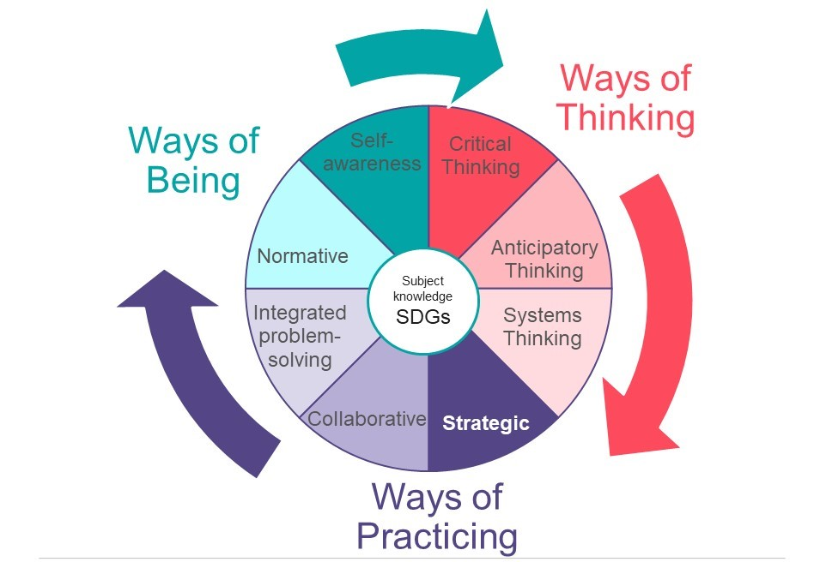
Teaching, Learning and Assessment for ESD
UNESCO key competencies
for sustainability

Slide 76
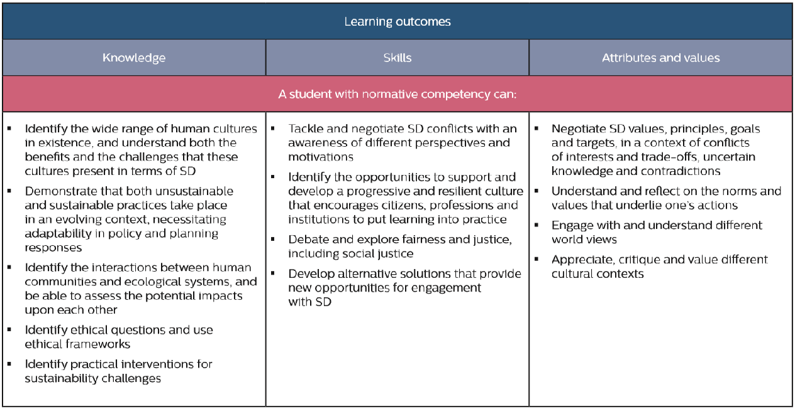
From competencies to learning outcomes

Slide 77
Section 4 – Annotated references and resources
International and UK policy and strategy frameworks
Open education resources
Perspectives on ESD and higher education experience
ESD curriculum design tools, frameworks and models

Slide 78
The revised guidance is available to download:
Advance HE Members
https://www.advance-he.ac.uk/teaching-and-learning/education-sustainable-development-higher-education
QAA Members
https://membershipresources.qaa.ac.uk
A free Executive Summary is available on each website.

Slide 79
Advance HE and QAA ESD Practice Guides
15 short, practice-based case studies intended to inspire others through providing practical examples of ESD activities - from single workshops to long-term community engagement projects.
ESD guides covering
Teaching, Learning and Assessment
Staff Development
Extra-curricular activities
Staff-student or student-led project
https://www.advance-he.ac.uk/teaching-and-learning/education-sustainable-development-higher-education

Slide 80
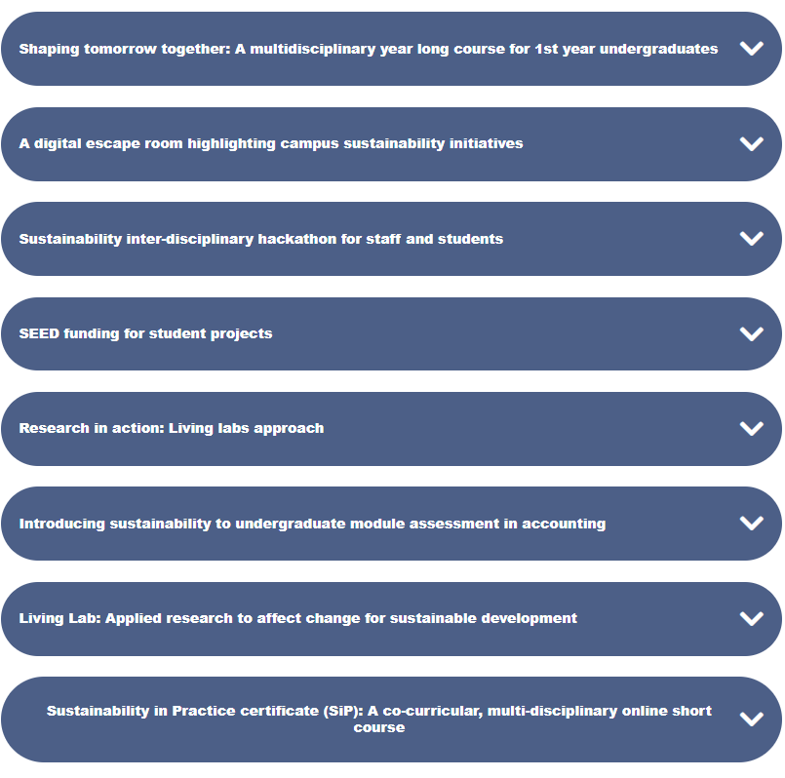
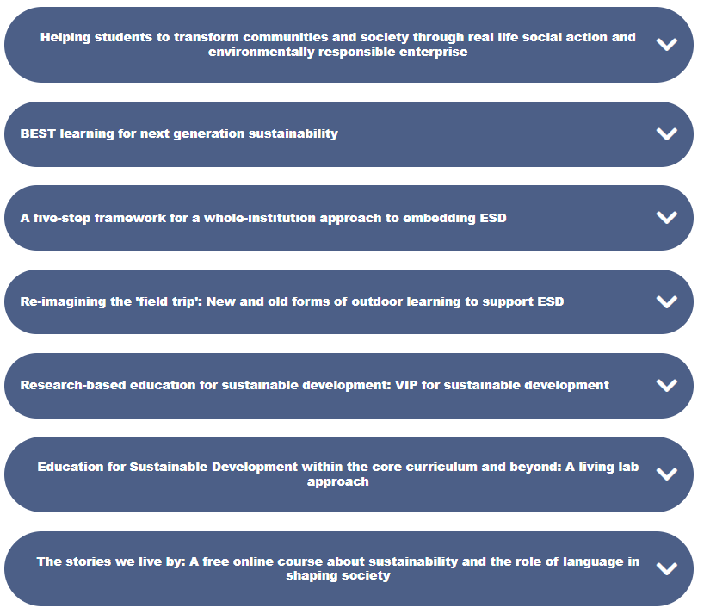
Practice guides 15 short, practice-based case studies intended to inspire others through providing practical examples of ESD activities - from single workshops to long-term community engagement projects.
https://www.membershipresources.qaa.ac.uk/teaching-learning-and-assessment/education-for-sustainable-development#
https://www.advance-he.ac.uk/teaching-and-learning/education-sustainable-development-higher-education

Slide 81
Advance HE Resources
Voices of Sustainability Blog
https://www.advance-he.ac.uk/knowledge-hub/voices-sustainability
Sustainable Development Toolkit: Tutor Resource and Student Activity Series https://www.advance-he.ac.uk/knowledge-hub/sustainable-development-toolkit-tutor-resource-and-student-activity-series
Webinar - Leading Sustainability in Higher Education: Leading for a Lost Cause?
https://www.advance-he.ac.uk/teaching-and-learning/education-sustainable-development-higher-education#reports

Slide 82
Getting Started with Education for Sustainable Development
Zoe Robinson, Keele University & Alex Ryan, University of Gloucestershire discuss how they have embedded Education for Sustainable Development in their institutions.
https://www.membershipresources.qaa.ac.uk/teaching-learning-and-assessment/education-for-sustainable-development

Slide 83
QAA ESD Resources – for Students
EDUCATION FOR SUSTAINABLE DEVELOPMENT: STARTING THE CONVERSATION - STUDENT RESOURCE
Publication date: 4 June 2021
Students at QAA Member institutions can use this resource to engage with their institution and students' union about ESD.
https://www.membershipresources.qaa.ac.uk/teaching-learning-and-assessment/education-for-sustainable-development

Slide 84
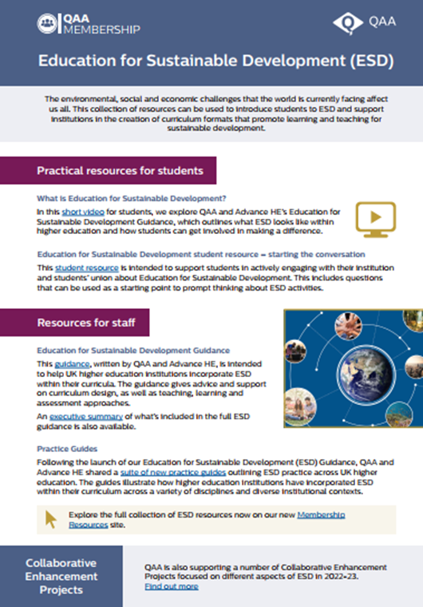
Education for Sustainable Development.
Useful Resources for Students and Staff Poster

Slide 85
QAA Projects to Support the ESD Guidance
Collaborative Enhancement Projects
ESD AND ACADEMIC QUALITY
https://www.qaa.ac.uk//en/membership/collaborative-enhancement-projects/education-for-sustainable-development/esd-and-academic-quality
DEVELOPING PHENOMENAL LEARNING: A TOOLKIT FOR IMPLEMENTING PHENOMENON-BASED LEARNING AS PART OF A FUTURE-PROOFED SDG HE CURRICULUM
https://www.qaa.ac.uk//en/membership/collaborative-enhancement-projects/education-for-sustainable-development/developing-phenomenal-learning-a-toolkit-for-implementing-phenomenon-based-learning-as-part-of-a-future-proofed-sdg-he-curriculum

Slide 86
QAA Projects to Support the ESD Guidance
Collaborative Enhancement Projects
STUDENTS DRIVING CURRICULUM QUALITY FOR SUSTAINABILITY - DEVELOPING CRITERIA & TOOLS
https://www.qaa.ac.uk//en/membership/collaborative-enhancement-projects/education-for-sustainable-development/students-driving-curriculum-quality-for-sustainability-developing-criteria-and-tools
MONITORING AND EVALUATING EDUCATION FOR SUSTAINABLE DEVELOPMENT IN HIGHER EDUCATION
https://www.qaa.ac.uk//en/membership/collaborative-enhancement-projects/education-for-sustainable-development/monitoring-and-evaluating-education-for-sustainable-development-in-higher-education

Slide 87
Resources Coming Soon
QAA Addendum to ESD Guidance to cover international activities in HE.
Probable publication 2023
Quality Management and ESD
To be drafted after the current crop of Enhancement projects complete

Slide 88
of ESD
Other Output
Simon Kemp & Jim Longhurst (2021) Climate, Environment and Sustainability: the Importance of Universities in Addressing the Climate Crisis. https://www.qaa.ac.uk//en/news-events/blog/climate-environment-and-sustainability-the-importance-of-universities-in-addressing-the-climate-crisis
QAA, Advance HE and UK ESD Advisory Group (2021)
Accelerating Education for the SDGs: New Higher Education Sector Guidance on Education for Sustainable Development.
In Accelerating Education for the SDGs in Universities. Sustainable Development Solutions Network.
https://blogs.upm.es/education4sdg/2021/07/27/accelerating-education-for-the-sdgs-new-higher-education-sector-guidance-on-education-for-sustainable-development/
“
UNESCO, 2019

Slide 89
ESD Principles to Support the Subject Benchmark Review Process
PRINCIPLE 1. Developing sustainable development knowledge. How can your subject area, and the content of your subject area, be focused towards addressing social, economic and environmental concerns to create a better world?
PRINCIPLE 2. Developing sustainable development competencies. How can UNESCO’s key competencies for sustainability (see ESD guidance p20) be developed within the subject area?
PRINCIPLE 3. Developing learning environments to promote sustainable development. ESD requires a learning environment in which:
• interdisciplinary or transdisciplinary learning approaches are facilitated
• learning is inclusive and accessible for all
• policies support synoptic assessment
• extra and co-curricular opportunities are provided and recognised
• learning spaces including the campus and outdoor environments are fully utilised to provide alternative locations to develop and express the competencies of ESD.

Slide 90
Benchmark Statements 2022
14 revised Statements were published in March 2022. These are the first to incorporate consideration of how practice within disciplines addresses Education for Sustainable Development.
Archaeology | Chemistry
Classics and Ancient History (including Byzantine Studies and Modern Greek) | Computing
Counselling and Psychotherapy | Criminology
Early Childhood Studies | Earth Sciences, Environmental Sciences and Environmental Studies
Forensic Science | Geography
History | Housing Studies
Policing | Theology and Religious Studies

Slide 91
Benchmarks and ESD: Chemistry
Chemistry courses may include topics drawn from the UN Sustainable Development Goals, particularly those associated with health, energy, clean water and the environment. Education for sustainable development is thus an integral part of the study of chemistry, ensuring that graduates are equipped with the knowledge, skills and competencies that can enable them to generate innovative solutions to complex challenges.
https://www.qaa.ac.uk/quality-code/subject-benchmark-statements/chemistry p5

Slide 92
Benchmarks and ESD: Computing
Across the Computing curriculum, we should be considering the broad definition of
sustainable development, which encompasses economic and social sustainable
development as well as environmental, and thinking about how the material that we teach
links to these goals.
There will be places where environmental sustainability can be discussed, for example, the resource consumption of massive data centres used for cloud computing, and more generally, the environmental costs of both building hardware to support computing and disposing of electronic waste.
Sustainable development also links with equality, diversity and inclusion; therefore, issues around social justice and economic prosperity can also be brought into the discussion in many areas of computing, alongside developing curricula that are global in outlook and that support inclusive lifelong learning and economic prosperity for all.
https://www.qaa.ac.uk/quality-code/subject-benchmark-statements/computing p6

Slide 93
Benchmarks and ESD: History
Environmental history in particular brings to the fore understanding of the interaction between nature and culture; how humans have affected the natural environments of the past; and how current problems are legacies of the past. However, public history, economic history and cultural history also focus on key aspects of sustainability.
History courses can also contribute to sustainability through their connection with heritage and work around conservation, preservation and learning from the past to plan for the future. In this respect, there are demonstrable links between the subfields of environmental history and public history.
More broadly, history prepares students to meet sustainability needs and challenges through its inherent attention to issues of change, continuity and causation; its demand for multi-perspectivity and multi-factorial understanding of events, issues and problems; its appreciation of the relationships between economic, political, cultural, social and environmental factors and systems; its ability to observe processes taking place in more than one place and more than one time; and its acknowledgement that there are rarely simple answers to problems.
https://www.qaa.ac.uk/quality-code/subject-benchmark-statements/history p6

Slide 94
Benchmarks and ESD: Policing
Programmes should be designed with reference to the United Nations 17 sustainable development goals from which the following provide the opportunity to be explicitly placed within the Policing curricula:
• Promoting the benefits of healthy lifestyles and wellbeing for all
• Ensuring education is inclusive, equitable and accessible, while promoting the benefits of life-long learning
• Reducing inequality and ensuring equity of opportunity
• The direct links between economic vitality, entrepreneurship, job market skills and levels of education
• Ensuring the sustainability of communities by making them safe, inclusive and resilient
• Considering the impact of policing on environmental sustainability
• Ensuring peaceful and inclusive societies with access to equitable justice for all
• The benefits of partnership working locally, nationally and internationally.
https://www.qaa.ac.uk/quality-code/subject-benchmark-statements/policing p7

Slide 95
Benchmarks and ESD: Theology and Religious Studies
ESD can be promoted in TRS courses by aligning content, pedagogy and assessment with the eight UNESCO sustainability competencies.
• Systems thinking competency evaluating connections between environmental impacts and religious, spiritual and secular beliefs, practices and communities
• Futures thinking competency envisioning alternative pathways to more sustainable futures, reflecting the contribution of religion and spirituality as part of wider societal transformation
• Critical thinking competency understanding the roles of religious and spiritual
actors in promoting and resisting sustainable development, and identifying dissonances between ideology and practice or belief and action
• Strategic competency identifying ways in which religious and spiritual professionals and organisations can exert influence, lead change and encourage action towards sustainability
https://www.qaa.ac.uk/quality-code/subject-benchmark-statements/theology-and-religious-studies p6

Slide 96
Benchmarks and ESD: Theology and Religious Studies
Collaborative competency engaging collaboratively with different religious, spiritual and non-religious groups to develop mutually beneficial ways of supporting progress on shared sustainability concerns
Problem-solving competency applying religious or ethical perspectives, and values-led thinking, to the real-world challenges associated with sustainable development
Self-awareness competency understanding the role of religious commitments, ideological influences and ethical traditions in shaping personal perspectives on sustainability
Normative competency analysing the diversity of religious, spiritual and nonreligious standpoints on environmental concerns, and the ways in which they can obstruct or support action on sustainability.
https://www.qaa.ac.uk/quality-code/subject-benchmark-statements/theology-and-religious-studies p7

Slide 97
Benchmark Statements Under Review
14 more benchmarks are being reviewed this year, revised Statements were published in March 2022. These are the first to incorporate consideration of how practice within disciplines addresses the wider social goals of equality, diversity and inclusivity; Education for Sustainable Development; requirements of disabled students; and enterprise and entrepreneurship.
Anthropology | Languages, Cultures and Societies
Biomedical Sciences | Law
Biosciences | Linguistics
Business and Management | Mathematics, Statistics and Operational research
Economics | Osteopathy
Engineering | Politics and International Relations
English | Psychology

Slide 98
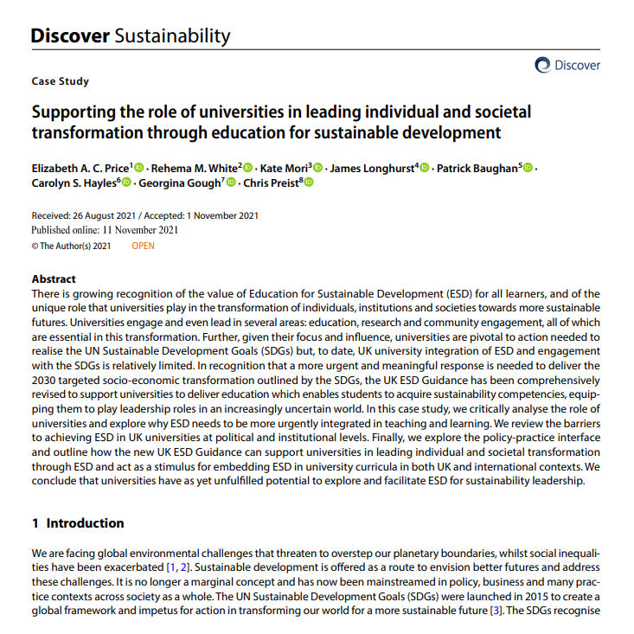
of ESD
Supporting the role of universities in leading individual and societal transformation through education for sustainable development
Discover Sustainability
https://link.springer.com/article/10.1007/s43621-021-00058-3
Last year a small group of the ESD Advisory Group published an open access paper in Discover Sustainability exploring some of the implications of the ESD Guidance.

Slide 99
of ESD
ESDG Advisory Group
Meg Baker, Students Organising for Sustainability
Dr Patrick Baughan, Advance HE
Associate Professor Georgina Gough, University of the West of England, Bristol
Dr Catherine Hack, Advance HE
Professor Carolyn Hayles, Cardiff Metropolitan University
Professor Peter Higgins, University of Edinburgh
Professor Simon Kemp (Co-chair), University of Southampton
Professor Jim Longhurst (Co-chair), University of the West of England, Bristol
Professor Petra Molthan-Hill, Nottingham Trent University
Dr Kate Mori (convenor), Quality Assurance Agency for Higher Education
Professor Liz Price, Manchester Metropolitan University
Professor Chris Preist, University of Bristol
Professor Zoe Robinson, Keele University
Dr Alex Ryan, University of Gloucestershire
Quinn Runkle, Students Organising for Sustainability
Professor Clare Saunders, University of Exeter
Associate Professor Paul Warwick, University of Plymouth
Dr Rehema White, University of St Andrews
Dr Emma Wilcox, Society for the Environment
“
UNESCO, 2019

Slide 100
The Sustainability Agenda Matters
It can and must be part of a university mission
It needs Senior Management leadership.
It matters to current students.
It matters to future students.
It matters to staff.
It has a place
in the curriculum of EVERY discipline,
in the university’s research activities,
In the management of the campus and
In the civic / community engagement activities of a university
.

Slide 101
Professor James Longhurst
University of the West of England,
Frenchay Campus,
Bristol,
BS16 1QY
UK
Email James.Longhurst@uwe.ac.uk
Public profile
https://people.uwe.ac.uk/Person/JamesLonghurst
Sustainability at UWE
https://www.uwe.ac.uk/about/values-vision-strategy/sustainability
UWE website
https://www.uwe.ac.uk/

