Slide 1
Participatory Backcasting for Achieving Desired Co-produced Mobility Futures: A Case Study of MaaS in Greater Manchester
Sigita Zigure
Mahmud Tantoush
Solon Solomou

Slide 2
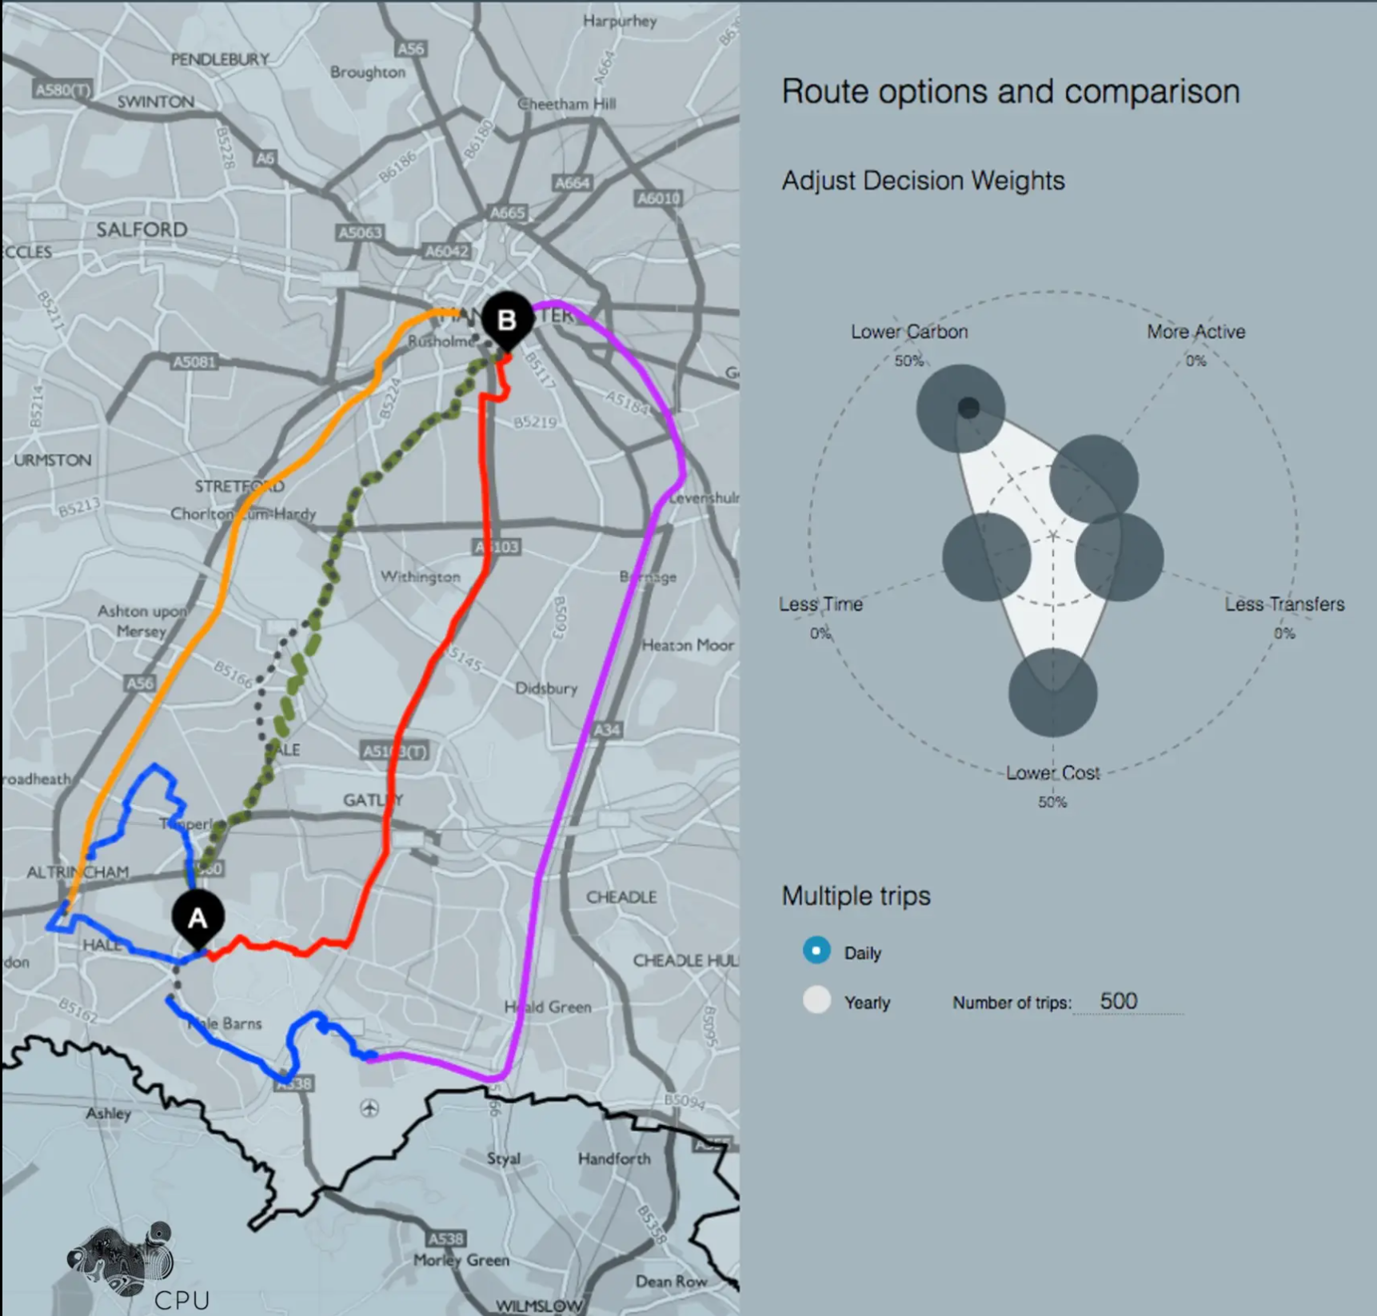
Who are we
Complexity, Planning and Urbanism (CPU) is a research laboratory at the Manchester School of Architecture. CPU uses a complexity framework to develop new digital tools, computational thinking and urban theory addressing future ICT disruptions and spatio-temporal dynamics in urban processes. The transdisciplinary research spans planning for evolutionary and emergent city systems, digital participation and inclusion, data platforms for resilient cities and urban simulations for sustainable future scenarios.
Website: http://www.complexurban.com/site/cpu/
Twitter: @complexurbanism

Slide 3
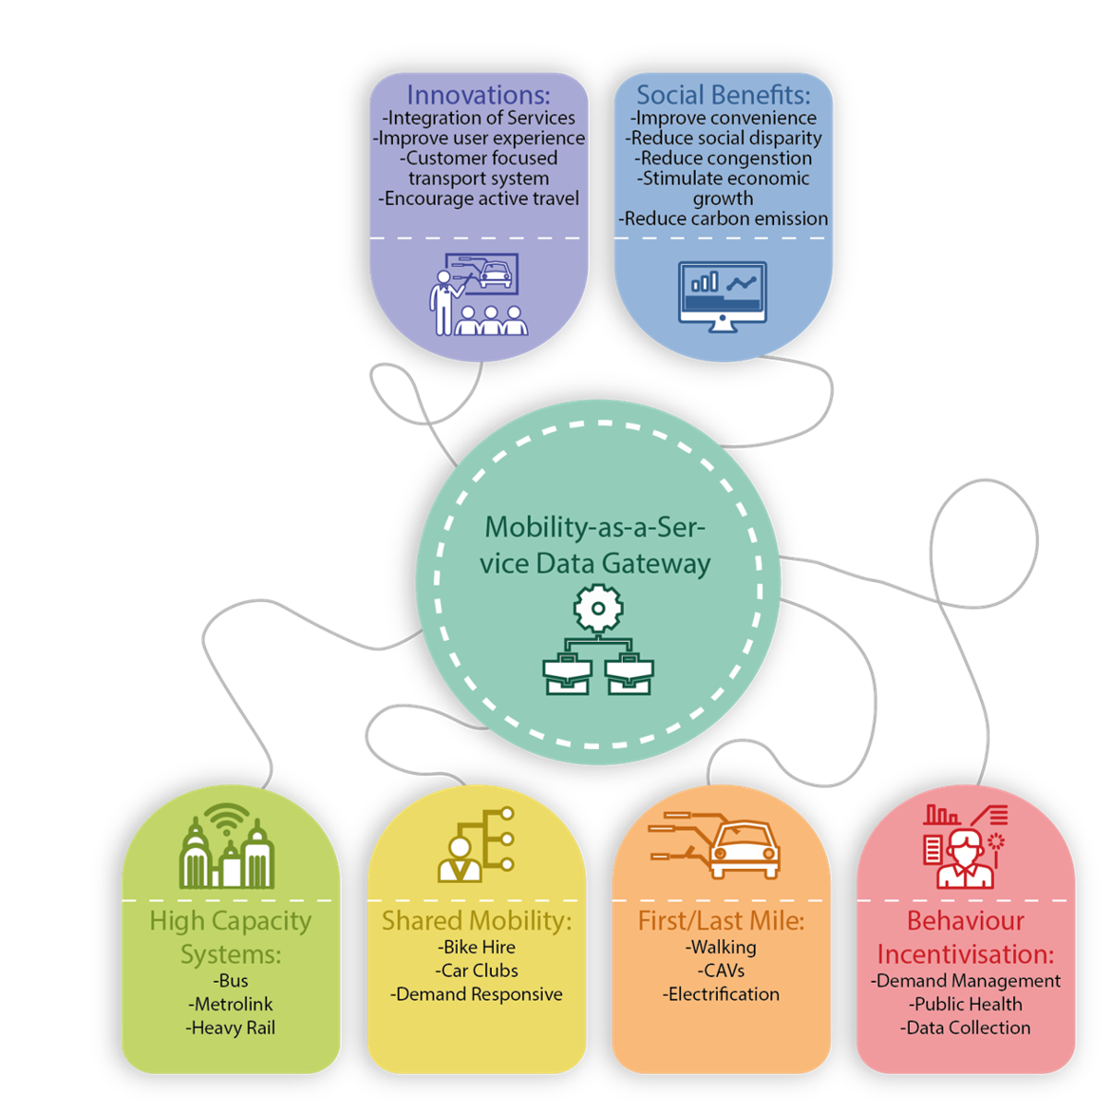
About the project & MaaS
This project is funded by the DEAS Network Plus. The aim of the project is to develop a MaaS prototype that is specific to the Greater Manchester context and considers everyday user preferences. To achieve this, the research run a number of workshops and a user survey to reveal future policy pathways towards better transport services in Greater Manchester.
Research was conducted online using MS Forms and Miro platforms.

Slide 4
Project Map

Slide 5
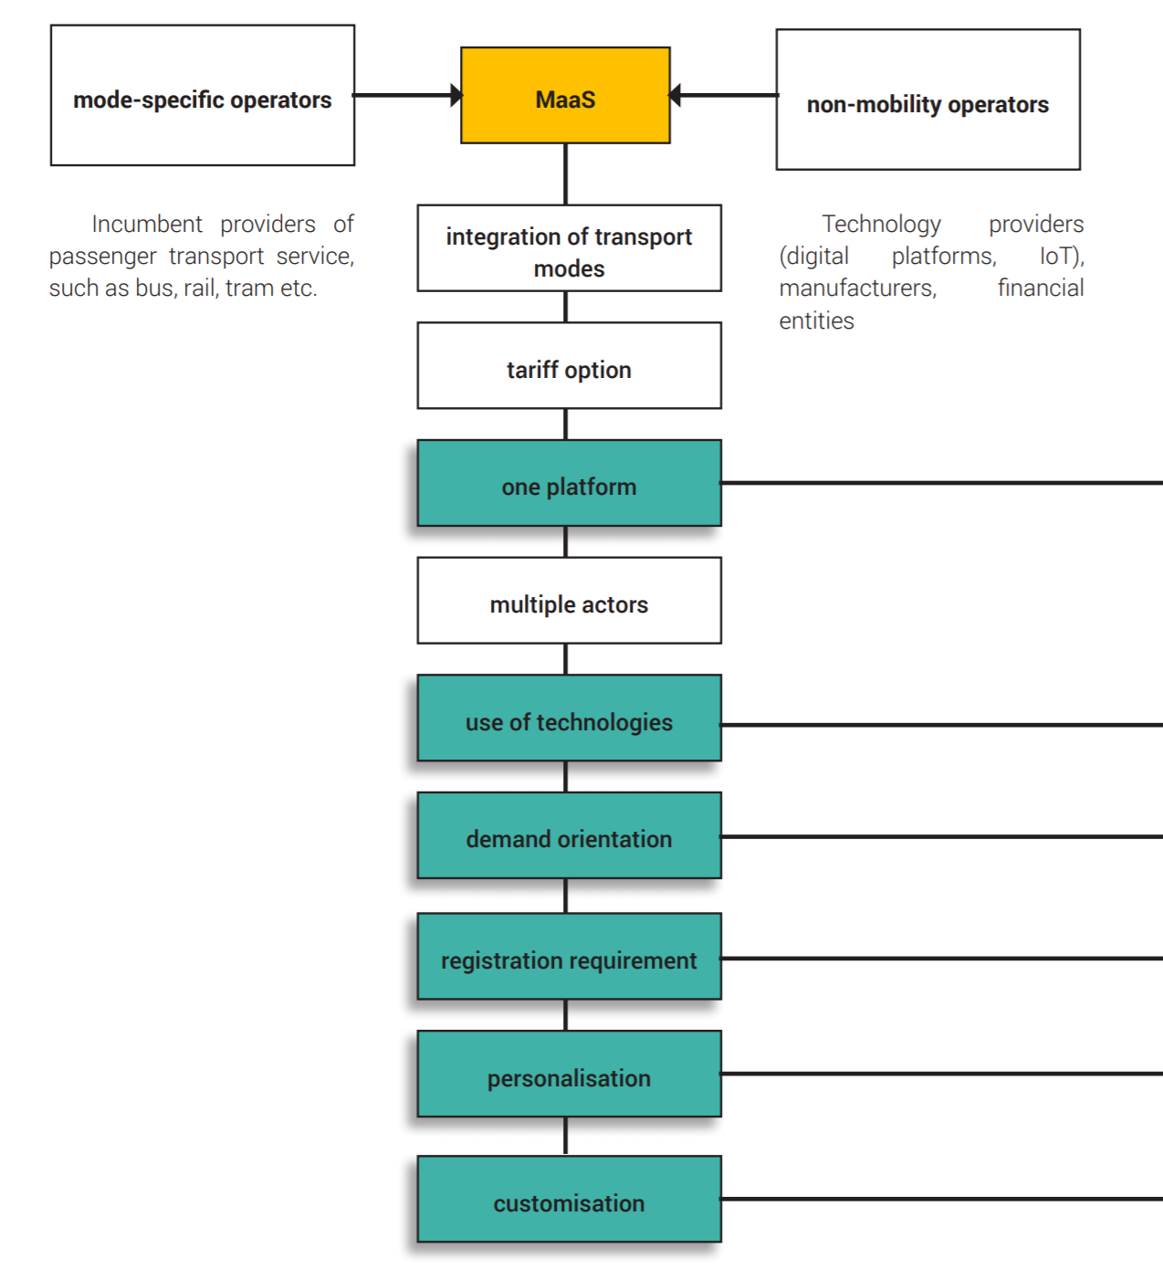
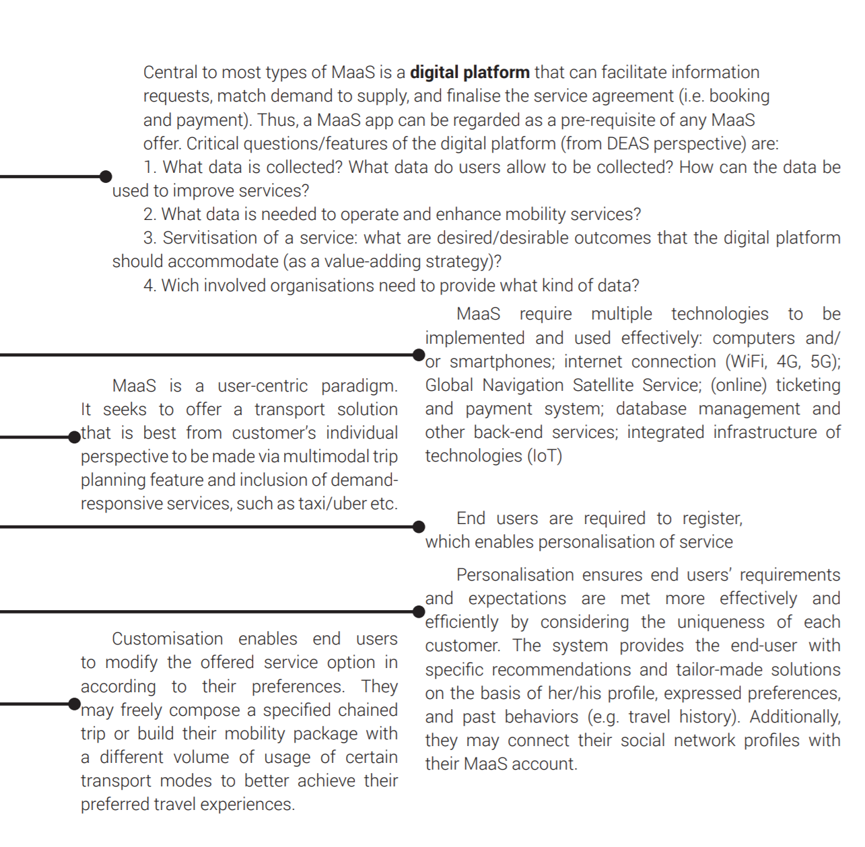
MaaS overview
(our) MaaS Definition:
A user-centric multi-modal mobility service platform that delivers optimised advanced services for all involved parties through utilisation of novel technologies and data.

Slide 6
Transport in Greater Manchester
Greater Manchester is a region in the United Kingdom and has a population of 2.8 million people. It covers an area of 1,276 km2 (493 sq mi) and consists of 10 metropolitan districts.
Recent statistics show residents of the area are highly dependent on private vehicles for their daily transport activities. In 2016 around 70% of residents commuted to work by private vehicles. Greater Manchester, therefore forms a prime candidate for MaaS given its current high levels of car usage, despite significant levels of investment in public transport. Furthermore, bus service in Greater Manchester is deregulated by nature as private companies bid for specific bus routes and services.
«We want at least 50% of all trips in Greater Manchester to be made by walking, cycling and public transport by 2040»

Slide 7
Ambitions for GM
Greater Manchester has a focus on future mobility and how it can support rapid progress towards the Greater Manchester Transport Strategy (GMTS2040) vision. This vision includes the delivery of “world class connections that support long-term sustainable economic growth and access to opportunity for all”. Within the GMTS2040 there are four supporting goals:
1. Protecting our environment
2. Developing an innovative city-region
3. Supporting sustainable economic growth
4. Improving quality of life for all

Slide 8
Introduction
The ambition of the research was to investigate MaaS from a specific perspective, which aligns with:
a) MaaS is heavily focused on and enabled by digitalisation and business dimension of transportation provision models;
b) DEAS principles and research agenda, which is based on:
• customer driven outcomes;
• technology and data driven;
• change in value proposition.

Slide 9
MaaS Business Models
Figure 1. MaaS business models on centralised - decentralised scale (adapted from Eckhardt et al. (2017).

Slide 10
Methodology

Slide 11
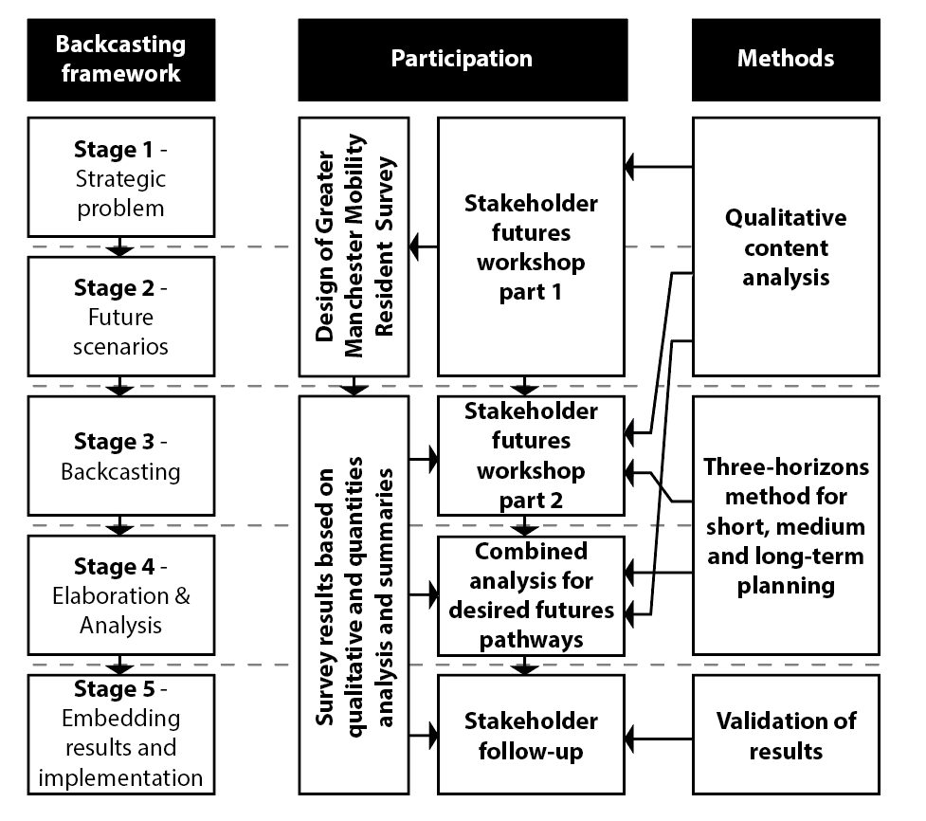
Methodology
Quist and Vergragt (2006)
Participatory backcasting is a generalised methodology that can incorporate a variety of
different futures methods for the development of transition pathways and strategies involvingkey stakeholders to taking part in strategic decision making and policy (Vergragt and Quist, 2011; Tuominen et al., 2014; Li et al., 2019).
Figure 2. Methodological approach adapted for pluralistic participatory backcasting.
Notes:
A backcasting methodology, in contrast to forecasting which is grounded in the principles of causality determinism, is centered around solution finding, design of strategies and action pathways for an identified desired future (Banister and Hickman, 2013).
Participatory backcasting is a generalised methodology that can incorporate a variety of different futures methods for the development of transition pathways and strategies involving key stakeholders to taking part in strategic decision making and policy (Vergragt and Quist, 2011; Tuominen et al., 2014; Li et al., 2019).

Slide 12
Participatory Backcasting
For our case study, we adapt the five stage of the participatory backcasting methodology in the following manner:
Strategic problem orientation: by organizing and facilitating an initial stakeholder workshop (workshop 1), this stage draws parallels to the first two stages of the preparation and critique phase in the futures workshop methodology (Jungk and Müllert, 1987). Participants were asked to critique the current state of mobility in GM to identify mobility related concerns unique to GM.
Construction of sustainable future visions or scenarios: The second stage of the initial workshop (workshop 1) organized was framed around the development of desired MaaS future scenarios for GM. This stage is akin to the fantasy phase staged of the futures workshop methodology (Jungk and Müllert, 1987). Participants were asked to engage in ‘fantasy’ thinking and illustrate multiple future scenarios suitable for GM, and not to limit their visioning exercise by current technologies and norms. The results of workshop 1 (stage 1 & 2) were then used to design a GM resident survey to understand preferences and attitudes to mobility from a citizen’s perspective
Backcasting; Through a second stakeholder workshop (workshop 2), we use the ‘Three Horizons’ method (Curry and Hodgson, 2008) for backcasting to articulate pathways from the existing systems and conditions with the desired future scenarios co-designed in the construction of sustainable future visions or scenarios stage.
Elaboration, analysis and (action) agenda
Embedding of results and generating follow-up and implementation
Workshop 1
Resident Survey
Workshop 2
Follow-up

Slide 13
Futures methodology
Workshop 1:
The preparation phase: Here the themes, the invited participants, the methods, their rules and the timetable of the workshop are settled by the organizers of the workshop and the facilitators.
Strategic Problem Orientation: Here the problem is critically and thoroughly discussed and investigated. Brainstorming is the preferred creative technique follow up by a structuring and grouping of ideas in some main sub-themes.
Construction of sustainable future visions and scenarios: Here the participants try to work a utopia, to draw an exaggerated picture of the future. Brainstorming and other creative technique might be used. The social fantasies of the participants are developed in this phase.

Slide 14
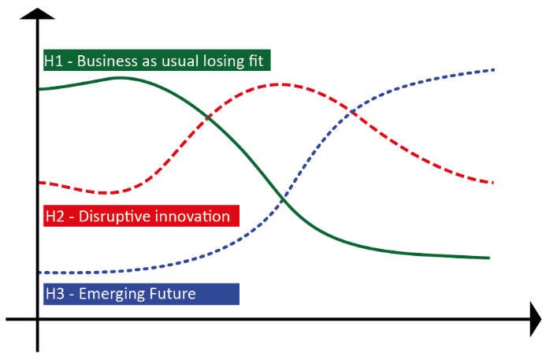
Backcasting: Three Horizons Method
Workshop 2:
Three Horzons Method connects the present with desired futures, and helps to identify the divergent futures which may emerge as a result of conflict between the embedded present and these imagined futures. In doing so it enables the futures analysis to be connected to underlying systems and structures, to the different speeds of change in different parts of the system, and also to tools and processes which facilitate strategic analysis. It is especially helpful where there is a potential transition (or transitions) which are likely to be disruptive rather than incremental.
Figure 3. Three Horizons model by Curry and Hodgson (2008).

Slide 15
Three Horizons Method: activity description
Horizon 1. For this activity, participants select elements of the existing mobility system and carry them through in the desired future state. All elements not carried through needed phasing out in stages. Participants needed to select the phasing out stage of each element. Existing mobility systems and concerns were established in workshop 1 and participants were encouraged to elaborate.
Horizon 3. Here, participants articulate technologies that might help achieve the desired future vision for MaaS in GM, overcoming the current limitations of horizon 1 system. Participants map changes and adoptions of innovations across stages with overlaps with aspects phased out from horizon 1 and potential policy changes needed to achieve the new uptake of the mentioned aspects. The participants contextualise the innovations and policy needs in achieving the desired future visions created in the first workshop. Participants mention any new technologies that have the potential to achieve that future and identify initial barriers and late barriers that the technology needs to overcome to achieve the desired future.
Horizon 2. Participants in the workshop had to identify existing technology that may contribute to enhancing the current system towards the future objectives. Following on, participants had to identify the impacts that technology may have in the short term and at a later stage the ability to decide on which of these new elements should be retained in the desired future.

Slide 16
Sustainable Future Visions and Scenarios
Workshop 1 findings

Slide 17
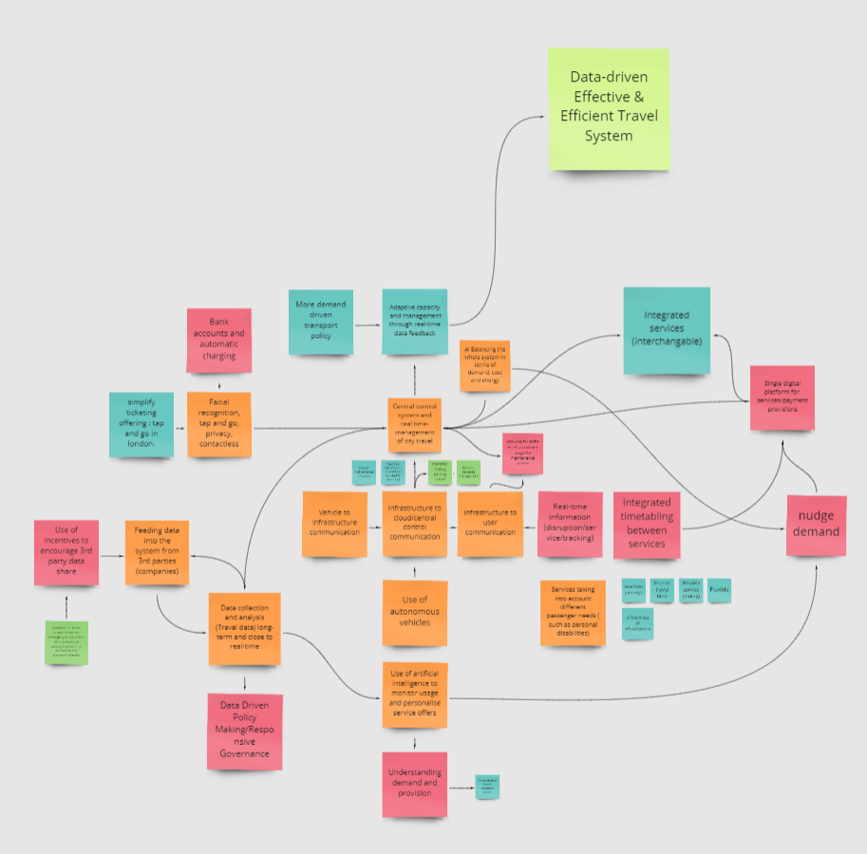
Centralised:
Central top-down control
Data and efficiency driven
Adaptive capacity

Slide 18
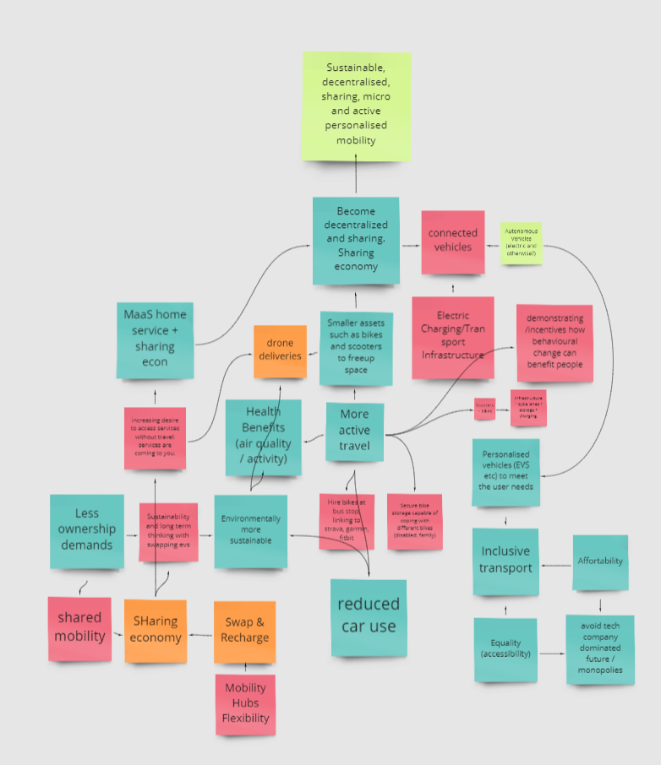
Decentralised:
Bottom-up model
Decentralised (no regulatory control)
Sharing
Micromobility
Behavioral shift
Active travel

Slide 19
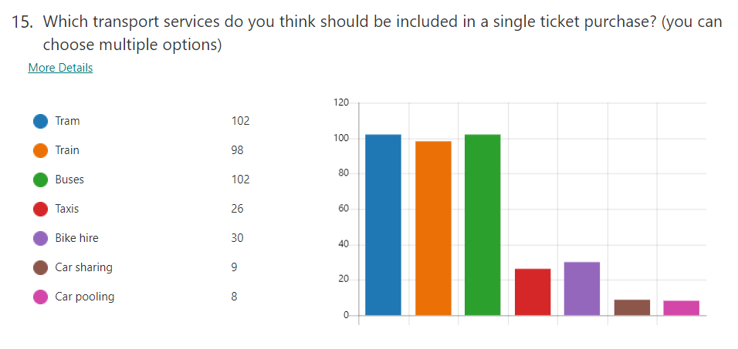
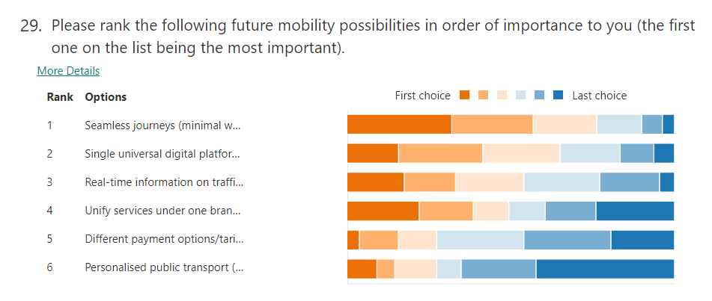
GM resident survey
Figure 5. Sample of survey results on the current attitudes and future preferences of MaaS for GM.

Slide 20
Backcasting : Three Horizons
Workshop 2

Slide 21
Workshop data (centralized scenario)

Slide 22
Workshop data (decentralized scenario)

Slide 23
Conclusions:
Action Pathways and Evaluation findings

Slide 24
Action Pathways: the data
Vision | Centralised | Decentralised
Horizon 1 Present Concerns | Cost of multi-modal services no competitive, GM transport not affordable, no data integration, reliance on open data not reliable, data mostly owned by companies and not shared across providers, Lack of safe cycling infrastructure, need to encourage more active travel, insufficient EV vehicle charging infrastructure, lack of communication infrastructure | Cost of multi-modal services no competitive, GM transport not affordable, no data integration, reliance on open data not reliable, data mostly owned by companies and not shared across providers, Lack of safe cycling infrastructure, need to encourage more active travel, insufficient EV vehicle charging infrastructure, lack of communication infrastructure, urban/rural split, currently it's easy to own a private car
Horizon 3 Future Visions | Centralised control system (AI) with real-time management of city travel, balancing demand cost and energy, integrated services (including timetabling), V2I, I2X, V2X, Real-time information availability (disruptions/tracking), Data-sharing incentives, Data used to drive policy and adaptive capacity, efficient use of infrastructure and services | Sustainable, decentralised, sharing, micro and active personalised mobility, MaaS to facilitate shared and personalised micro-mobility for all, promote active travel, reduce overall carbon emissions in the transport sector, peer-to-peer communication and management of mobility assets, MaaS digital platform to monitor and maintain assets and provide personalised peer-to-peer exchange and home deliveries, V2V, V2I, Data used for monitoring and connecting people with the mobility assets, incentivised behavioural change towards active travel
Horizon 3 emergent technologies | Biometric identification, Urban air mobility, Connected Autonomous Vehicles, Drone deliveries, Digital connectivity, 5G network, mobile data analysis, Digital Mobility Platform (for MaaS), Satellite technology for monitoring and communication, mobile data analysis, smart junctions | Use of AI, drones, connected EV, swappable solid-state batteries, biometric payment, sharing economy systems, micro mobility, open collaboration between businesses and local government, 5G network, IoT and edge computing towards edge utilities.
Horizon 2 Short to mid-term action pathways (triangle of change) | Reduction in private car usage as well as petrol/diesel usage, more fast EV charging points commercially rolled out with incentive schemes for the adoption of EV vehicles, Renewable energy generation, improve public perceptions on new technologies and mobility platform, bypass initial technological barrier, shift infrastructure investment to prioritise CAV network, improve data security, design vertiport infrastructure, build trust with early assisted tech and regulation around it, finish 5G infrastructure for V2I, V2X, I2X communications, revise air traffic regulation, transition away from car usage for short trips with the use of council green fleets, implement clean air zones, expand cycling network, create a digital mobility platform for GM | Use of social media and communication strategies to raise public awareness and acceptance for shared mobility, unmanned vehicle travel and cash removal, achieve critical mass of users, introduce local air travel, behavioural change towards sharing assets, improve street charging and introduce swappable batteries, improve data privacy, solve insurance issues with CAV, improve infrastructure and design in accordance with CAV/EV suitability with swappable batteries, commercial viability of multi-transport system platforms, install 5G infrastructure for V2X and V2I, introduce micro-mobility such as bike and scooters, introduce digital platform (MaaS) to facilitate mobility achieve zero data latency with CAVs, find feasible business model for fare fees imposed on customers and operators, replace fossil fuel usage in transportation with clean energy, reduce private car usage and promote sharing assets, increase running costs on petrol cars, regenerate local centres, national guidance and policy, improve data collection, policy change to accommodate sharing as well as insurance provision for shared assets, more cycle lanes for promotion of active travel
Long-term action pathways | Promote shared usage of vehicles and Resolve Tax implications and operational issues (who services etc) in shared assets, improve cybersecurity of digital mobility platform, retrofit assets with new technology, use incentives to encourage 3rd party data sharing for feeding into a centralised data collection and analysis system close to real-time, simplify ticketing offering tap and go or facial recognition frictionless public transport journeys, use data for wider understanding of service demand and supply with TfGM to facilitate connection between demand and supply, shift behaviour of the system to adaptive with a central management system, reduce the use of freight lorries in city centre, achieve integration between services, DfT to write policy or regulation for sharing of data, Decommission physical signs and signals, ban petrol cars, further reduction in private car usage | Improve collection, cleaning and security of data to balance services, finalised insurance and liability with the use of national regulations, introduce specialised infrastructure to park and maintain systems, on demand rapid transportation with autonomous driving public transport systems, need for commercial standards for sharing data and use of universal platforms involving fees, achieve real time maintenance reporting, introduce infrastructure for sharing economies, use data to improve CAV systems with data standards and systems converging to deliver services to customers, contactless future payment method,, Cycle to work schemes, discounts on travel for certain groups for accessibility and affordability for all, introduce clean-air zones particularly in urban centres, introduce more home deliveries to discourage travel for shopping and smaller tasks, introduce regulation on emissions and a ban on petrol cars

Slide 25
Short-mid term
In the short-mid-term, both scenarios aim to:
reduce private car usage and reduce the use of fossil fuel powered vehicles
promote Electric Vehicles (EV)
Public engagement campaigns
Infrastructure improvements in three parts:
communication and enabling V2I and V2X communications;
prerequisite infrastructural requirements for CAV rollout;
increased provision of cycle lanes.
Urban centre reforms
Creation of a digital mobility platform (for MaaS)

Slide 26
Long term
Both scenarios diverge more significantly as we move towards the long-term proposed changes, though some similarities in actions persist:
A ban on petrol cars
Introduction of CAV in the transport eco-system
Regulations and technology advancements facilitating increased data collection, sharing, security and analysis at real-time
Introduction of improved payment methods for frictionless journeys
This pluralistic approach enabled the stakeholder to learn and better understand how the different scenarios compare through opening up a discussion on adaptable, integrated policy and action pathways for potential disruptions.

Slide 27
Stakeholder Ambitions
The survey revealed that the GM public values seamless journeys as the most desirable aspect alongside the creation of a single MaaS digital platform for the purchase and planning of all mobility services.
Government stakeholders value the creation of new payment methods while the public ranked that aspect as one of the least important.
Public is primarily concerned with reducing travel time along with a single MaaS digital platform for ease of planning, purchasing and managing all transport services in GM.
Government and operator stakeholders emphasised data generation, collection and analysis, while consumers gave this aspect lower priority.

Slide 28
Thank you
Website: http://www.complexurban.com/site/cpu/
Twitter: @complexurbanism

